Slide 1
NordREG Hearing
Gardemoen, April 8th, 2015
Fortum Markets’ view on the “market design” for energy services, as a supplier/service provider
- Louisa Ramert, Fortum Markets

Slide 2
Expectations of Customers vs. Customers expectations of “Energy Services”
Customers expectations of Energy Services:
Comfort
Easiness
Choice
Customization and personalization
Online, real time access to information
Sustainability
Profitability
Expectations of customers:
Demand side participation
Load shifting
Price sensitivity
Micro production
Local storage
Energy Services
Today’s Nordic retail market framework does not yet meet the customers’ nor the energy system’s future needs with respect to development of energy services

Slide 3
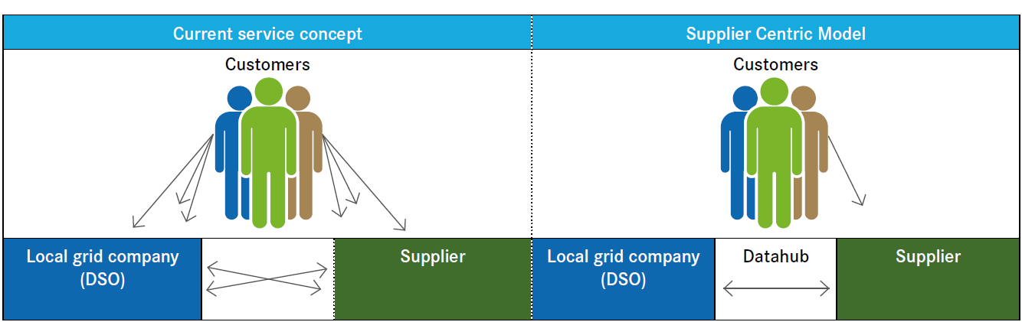
To support the development of energy services we need a market driven approach with the supplier centric model as a base
A market model where the supplier/commercial party is responsible for the interface towards the customer is a key prerequisite for the development of customer driven solutions.
Efficient data exchange between the market participants through data hubs.
Mandatory combined billing
Notes:
A recent study in Finland showed that more than 40% of customers would likely decline a competitive offer if it led to separate invoices. In the longer perspective, service offering development and market efficiency are outweighing the combined invoice as reasons for implementing the supplier centric model.

Slide 4
A harmonised market with a level playing field
A more harmonised market is a more attractive market - market size is key when launching new products and services
New players should compete on the same terms as existing
All commercial players should have the same possibility to access information about the customer
Sufficient unbundling needs to be ensured

Slide 5
Clear roles and responsibilities is fundamental
Clear distinction between commercial and regulated activities
  Energy services should be developed in the competitive market
  DSO role with focus on core activities
Clear allocation of responsibilities!
  Information handling: Data collection, administration, validation, quality, allowing access etc.
  Balancing
  Billing
  etc.

Slide 6
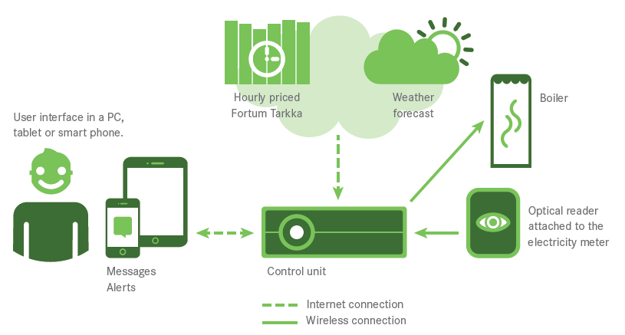
We need to empower customers through development of the retail market
In the Nordics, recent years have seen notable investments in meters and smart grids, which should be utilised
Hourly metering and hourly settlement - prerequisites to start incentivising customers to become active market participants.

Slide 7
Thank you!

